Slide 1
Trust in the Social Sciences
British elections and polling
Jane Green

Slide 2
Problems of polling in GB elections
2015: predicted a hung parliament, Labour largest party, result a Conservative majority
Prediction models almost all coalesced around a hung parliament
Commentators coalesced around a hung parliament
Polling companies coalesced – more than we’d expect by chance – around hung parliament
2016 EU ref: surge in support for Leave in the campaign, roughly 50:50 remain/leave majorities, but commentary almost entirely predicted Remain
2017: predicted Conservative majority – Conservatives lost their majority

Slide 3
How should we have responded?
People changed their minds at the last minute
Undecided voters split in one direction
Respondents weren’t truthful to pollsters
The predictions were wrong
Predictions should not have been so confident in the first place

Slide 4
What did 2015 teach us?
Majority view ≠ greater certainty
More data ≠ greater certainty
Consensus in prediction or interpretation ≠ greater certainty
If the data are wrong, everything else will be

Slide 5
Deeper lessons
Emphasise the limits of your knowledge / data
Emphasise the limits of your certainty
Be open to other interpretations/answers
Don’t predict in public
I would say very few public social scientists responded like this
Why?

Slide 6
Call yourself an expert

Slide 7
The call to provide the answer
Demand
Providing certainty in an uncertain world
Betting markets, financial markets
The supply
‘Impact’ – I’m doing my duty
Competition – I’m right, others are wrong
Status – aren’t I important
Attention – look at me! Validation
Fear of looking ignorant

Slide 8
What’s going to happen?

Slide 9
The danger of prediction
Certainty where it isn’t justified
Setting social science up for a fall
Protecting your own reputation
Echo chambers in interpretation
More and more people are watching and listening
Missing the opportunity to better understand

Slide 10
Twitter use in the UK over time (millions)

Slide 11
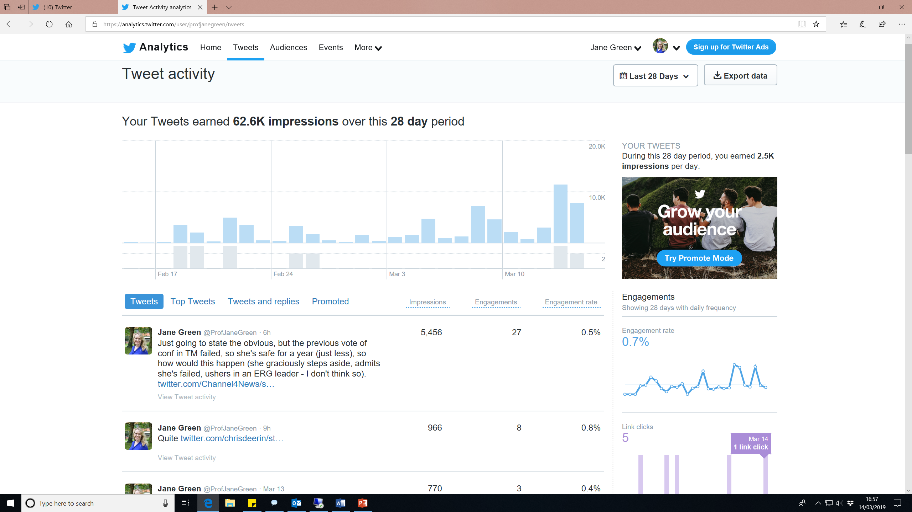
Notes:
I have 5,277 twitter followers

Slide 12
A possible approach
Be honest
What we know, what we don’t know, why…
Speak out, use your voice - when you have something to contribute
Don’t be silenced by others
Trust
Know where your confidence comes from
Trust God’s leading – not the validation of others
Cut your own path, driven by your values
Have healthy boundaries

